Slide 1
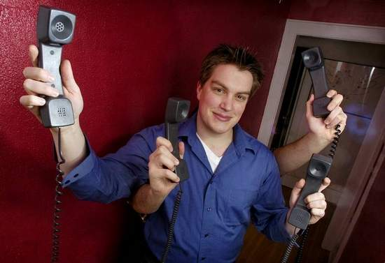
Strength In Numbers Hollis Easter
www.holliseaster.com/talks/

Slide 2
Who is this bozo, and why is he talking to me?
Program director since 2004; hotline worker since 1995.
National secretary, Contact USA 2006-2010, co-author of national training standards
Lead instructor, National Youth Pipe Band of Scotland
And many other impressive credentials

Slide 3
By Glassblower Most of us teach like this is our learner.
3

Slide 4
“Migrant Mother” by Dorothea Lange
4

Slide 5
“Graduation” by Kenneth Hynek
3

Slide 6
Jabba the Hutt
2

Slide 7
This guy!
1

Slide 8
Ground rules
Questions are good! (flipchart)
Try it!
You are smart!

Slide 9
Small group 1
Name / where you’re from
Most unusual training
Your roles at work

Slide 10
Small group 2
What kinds of training do you do?

Slide 11
Small group 3
Best experience of being taught
Who taught? What format? What made it good?

Slide 12
Small group 4
Find the other people with same color card
Work on your assigned question – be prepared to report your conclusions

Slide 13
Small group 5
Find the other people with same number (any color)
Report on your color’s conclusions

Slide 14
How did it go?
What did you learn?
What did this make you think about?
How did you feel?

Slide 15
Socratic questions
How would Socrates describe this picture? How would he lead you toward the answer?

Slide 16
WAIT: Why am I talking?
Short attention span
QA: how do I assess my learners when I’m doing all the talking?
Learning is stressful for adults—group work gives them time to defuse things

Slide 17
Adult learning theory
Motivated, self-sufficient, experienced, skilled, bored by lectures, sometimes inflexible
“Andragogy” is different from pedagogy
Social learning
Project-based learning

Slide 18
Elaboration
Cognitive information processing model
How does memory get stored?
How can we facilitate that in classes?

Slide 19
ADDIE
Analysis
Design
Development
Implementation
Evaluation

Slide 20
What the instructor does
Facilitate
Stay out of the way as much as possible
Have a sense of where we’re going, and how to get there
Leave room for the students to be the teachers—don’t fill each slide with all the answers

Slide 21
Questions
“Try to love the questions themselves, as if they were locked rooms or books written in a very foreign language. Don’t search for the answers, which could not be given to you now, because you would not be able to live them. . .

Slide 22
Questions
. . . And the point is to live everything. Live the questions now. Perhaps then, someday far into the future, you will gradually, without even noticing it, live your way into the answers.”
— Rainer Maria Rilke, “Letters to a Young Poet”

Slide 23
Good luck!
Hollis Easter easter@holliseaster.com holliseaster@gmail.com
www.holliseaster.com/talks/
5

